Slide 1

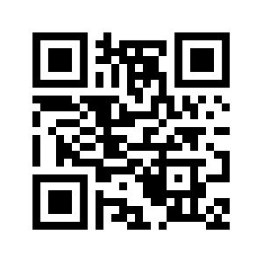
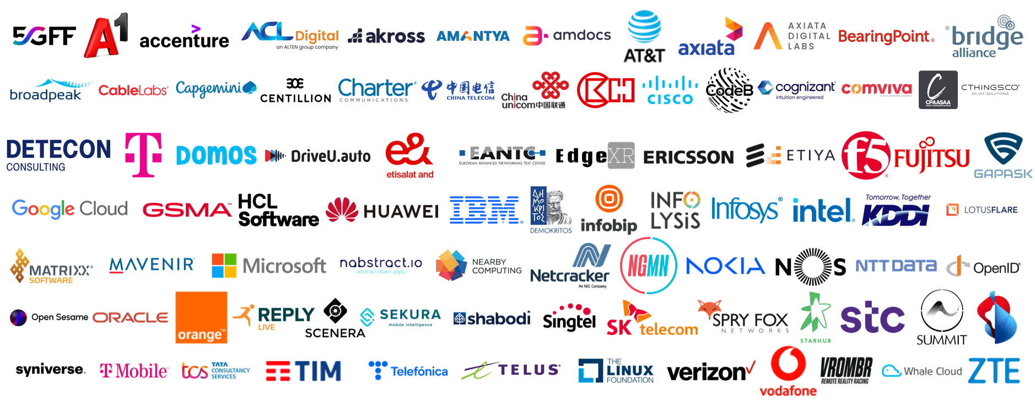
25.11.2023
APIs enabling seamless access to
Telco network capabilities
Telco network capabilities exposed through APIs provide a large benefit for customers. By simplifying telco network complexity with APIs and making the APIs available across telco networks and countries, CAMARA enables easy and seamless access.
Telco network capabilities are functions partly available already in 4G but new and much more powerful in the 5G network. These functions enable to get information out of the network but also to configure the network. The on-demand, secure and controlled exposure of these capabilities pave the way for transforming operator networks into service enablement platforms, facilitating the application-to-network integration, which will be key to deliver enhanced and service-tailored customer experience in the 5G era.
CAMARA is an open source project within Linux Foundation to define, develop and test the APIs. CAMARA works in close collaboration with the GSMA Operator Platform Group to align API requirements and publish API definitions and APIs. Harmonization of APIs is achieved through fast and agile created working code with developer-friendly documentation. API definitions and reference implementations are free to use (Apache2.0 license).
Abstraction from Network APIs to Service APIs is necessary:
To simplify telco complexity making APIs easy to consume for customers with no telco expertise (user-friendly APIs)
To satisfy data privacy and regulatory requirements
To facilitate application to network integration
Availability across telco networks and countries is necessary:
To ensure seamless customer experience
To accelerate technology development and commercial adoption (minimize implementation effort)
To accelerate education and promotion
To support application portability

